Slide 1

Excel Final Assement sheet Garvit Chawla
Employee number - 4279

Slide 2
Answer 7
Row Labels | Sum of likes | Sum of comment_count | Sum of dislikes | Sum of views
Autos & Vehicles | 189163 | 26945 | 9158 | 11331023
Comedy | 38804398 | 3117473 | 1609766 | 798799040
Education | 3529171 | 455965 | 118993 | 73816757
Entertainment | 83836195 | 8969633 | 6681076 | 4337761090
Film & Animation | 14308758 | 1196090 | 934036 | 941674037
Gaming | 1988458 | 178580 | 79523 | 68728039
Howto & Style | 4322796 | 411823 | 429296 | 395218494
Movies | 80026 | 4617 | 4984 | 7724380
Music | 54100112 | 3450605 | 3116666 | 2447689197
News & Politics | 5762909 | 1056430 | 981590 | 744883343
People & Blogs | 8841134 | 1032463 | 697899 | 554921583
Pets & Animals | 186307 | 21384 | 3322 | 2490776
Religious | 127654 | 7014 | 4730 | 3929208
Science & Technology | 9566636 | 3381982 | 396381 | 199386704
Shows | 427347 | 64106 | 132310 | 78556290
Sports | 9389714 | 786327 | 408669 | 478635632
Travel & Events | 13048 | 2236 | 387 | 771631
Grand Total | 235473826 | 24163673 | 15608786 | 11146317224

Slide 3
Answer 2
Average Time Gap Between Publish and Treanding Date
2.298154167
Formula Used Here
AVERAGE(Q2:Q16308)

Slide 4
Answer 3
Row Labels | Average of views2 | Sum of views | Count of comment | Sum of likes | Comments+like | EngagementRate Per Views
Autos & Vehicles | 333265.3824 | 11331023 | 2 | 189163 | 189165 | 0.016694433
Comedy | 717054.7935 | 798799040 |  | 38804398 | 38804398 | 0.048578423
Education | 92618.26474 | 73816757 | 116 | 3529171 | 3529287 | 0.047811461
Entertainment | 574766.2767 | 4337761090 | 194 | 83836195 | 83836389 | 0.019327111
Film & Animation | 1800523.971 | 941674037 | 24 | 14308758 | 14308782 | 0.015195048
Gaming | 3436401.95 | 68728039 |  | 1988458 | 1988458 | 0.028932267
Howto & Style | 826816.9331 | 395218494 | 13 | 4322796 | 4322809 | 0.01093777
Movies | 3862190 | 7724380 |  | 80026 | 80026 | 0.010360184
Music | 2017880.624 | 2447689197 | 4 | 54100112 | 54100116 | 0.022102527
News & Politics | 297358.62 | 744883343 | 108 | 5762909 | 5763017 | 0.007736805
People & Blogs | 450423.3628 | 554921583 | 82 | 8841134 | 8841216 | 0.01593237
Pets & Animals | 2490776 | 2490776 |  | 186307 | 186307 | 0.074798778
Religious | 56945.04348 | 3929208 | 42 | 127654
Science & Technology | 664622.3467 | 199386704 | 4 | 9566636
Shows | 649225.5372 | 78556290 |  | 427347 | Formula Used
Sports | 1379353.406 | 478635632 | 3 | 9389714 | Engagement Rate = Sum of comments +likes/Sum of views
Travel & Events | 192907.75 | 771631 |  | 13048

Slide 5
Answer 4
Category name
News & Politics
News & Politics |  | Formula Used
Comedy |  | XLOOKUP(E3,Category!$A$1:$A$33,Category!$B$1:$B$33,)
Comedy
Sports
Entertainment
Film & Animation
People & Blogs
Entertainment
News & Politics
Entertainment
News & Politics
News & Politics
News & Politics
Entertainment
People & Blogs
Comedy
Comedy

Slide 6
Answer 5
Formula Used
TEXTJOIN(",",TRUE,P:P)
CONCAT(C2,D2)

Slide 7
Answer 6
Here we can clearly see that the videos where the comment disabled flag is false has no comments associated with them and the videos where the flag is true has 592 comments in the them
Row Labels | Count of comment
FALSE
TRUE | 592
Grand Total | 592

Slide 8
Answer 8
Top 5 videos based on Sum of views
Row Labels | Sum of likes | Sum of views
FlsCjmMhFmw | 2912710 | 125432237
6ZfuNTqbHE8 | 2606663 | 89930713
u9Mv98Gr5pY | 1250535 | 53822757
QwievZ1Tx-8 | 1494997 | 45064699
bTJhO-hipjg | 235473826 | 11146317224
Top 5 videos based on Sum of likes
Row Labels | Sum of likes | Sum of views
Grand Total | 235473826 | 11146317224
FlsCjmMhFmw | 2912710 | 125432237
6ZfuNTqbHE8 | 2606663 | 89930713
dfnCAmr569k | 1804377 | 42019590
2Vv-BfVoq4g | 1721384 | 39082222

Slide 9
Answer 9

Slide 10
Answer 10

Slide 11
Answer 11

Slide 12
Answer 12
Here 100 views = 1 rupees
Row Labels | Sum of views | Revenue per views in rupees
#NAME? | 4427381 | 44273.81 |  | Formula used
#VALUE! | 206364 | 2063.64 |  | B4/100
__03GOeEMZI | 1508761 | 15087.61 |  | 100 views = 1 Rupees
__XaQ6q2ZbI | 534787 | 5347.87
__XgHijSqW8 | 134940 | 1349.4
_07-k5kkrlo | 763757 | 7637.57
_0M5IV3Z0ww | 795525 | 7955.25
_0R5MD6BqGw | 54075 | 540.75
_0Rv0Pw1FgA | 54116 | 541.16
_1iWMsOwyRY | 52669 | 526.69
_1lvresagmQ | 126373 | 1263.73
_1mPvuGxaBg | 267827 | 2678.27
_1YkdW_1kcM | 8917 | 89.17

Slide 13
Answer 13
Row Labels | Sum of comment_count
Autos & Vehicles | 26945
Comedy | 3117473
Education | 455965
Entertainment | 8969633
Film & Animation | 1196090
Gaming | 178580
Howto & Style | 411823
Movies | 4617
Music | 3450605
News & Politics | 1056430
People & Blogs | 1032463
Pets & Animals | 21384
Religious | 7014
Science & Technology | 3381982
Shows | 64106
Sports | 786327
Travel & Events | 2236
Grand Total | 24163673

Slide 14
Answer 14

Slide 15
Answer 15

Slide 16
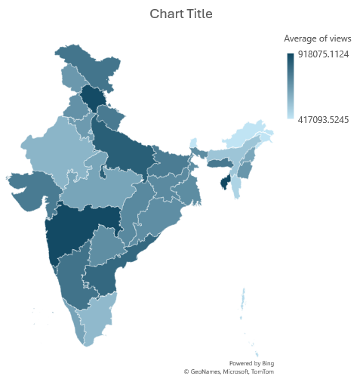
Answer 16
Inference
When I plotted average number of views per state for the given data We can clearly see that states of uttar Pradesh and Maharashtra are having hing number of average views

Slide 17
Answer 17
Here when we plot the scatter chart for sum of likes,views and comments for each category we can clearly see that Likes and comments are very closely related to each others but the views are different in many caese

Slide 18
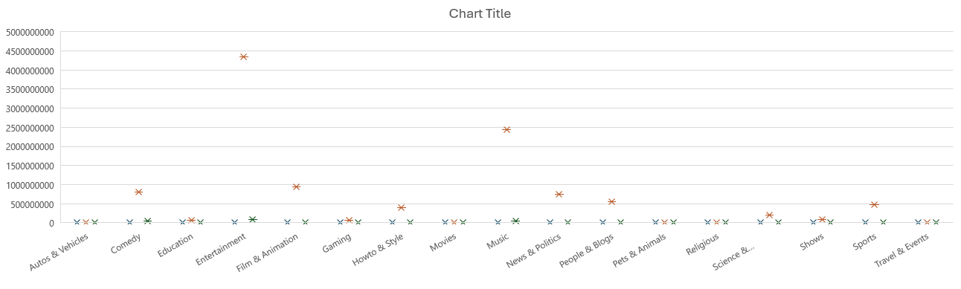

Slide 19
Answer 18
Here I have plotted sum of likes and dislikes for the category of comedy for all of its videos.
We can clearly see that sum of likes are constantly changing over time for this category but the number of dislikes remain more or less the same.

Slide 20
Answer 19
Here when I applied sum of likes , views and comments for a period of time of months, quarters and years.
We can clearly see here that all these three metrics took a sharp increase in the month of may in 2017 and then are almost constant since then.

Slide 21
Answer 20
Here I have plotted the number of views over a period of time in order to analyze the retention rates of the customres who in this case are the viewrs who are watching the videos.
We can clearly see that during the Q2 of 2017 the the retention rates started to climb very steeply but we see a very abrupt decrease in the retention rates again during the Q2 of 2028

